Slide 1
IoT Template

Slide 2
Agenda

Slide 3
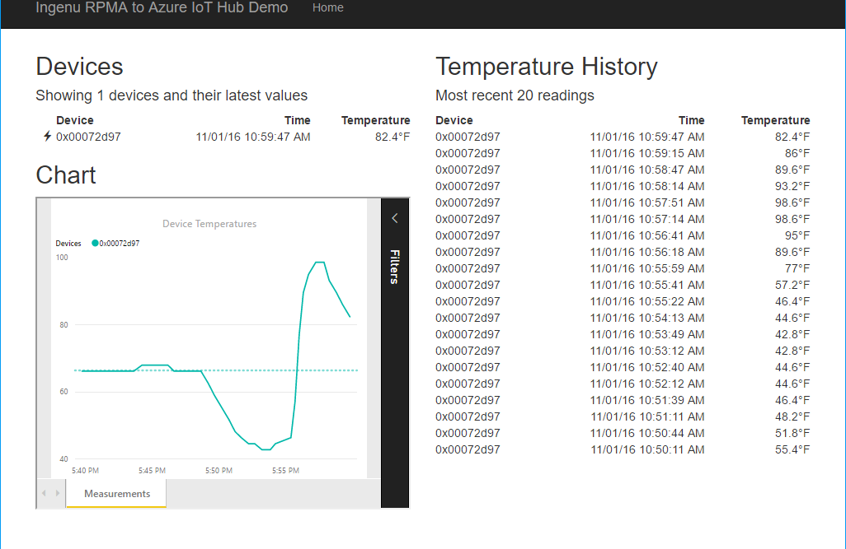


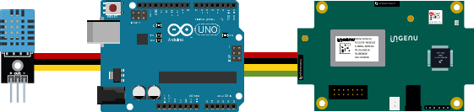
Resource Group <name>group
Power BI Embedded Collection ingenucollection
Power BI Embedded Workspace Dynamic GUID
RENDER
Power BI Report Temperature Chart
Storage Account ingenustorage
App Service Plan ingenuplan
READ/WRITE
Function App ingenufunctions
GET
Web App ingenuweb
QUERY
Function EventHub2IntellectRestJS
Function IntellectRest2IoTHubJs
QUERY
Service Bus Namespace ingenubus
SQL Server ingenusql
RECEIVE
SQL Database
ingenudb
Event Hub
ingenualerts
SEND
OUTPUT
OUTPUT
Stream Analytics Job ingenujob
POST
GET
AZURE
INPUT
RPMA to Azure
Architecture Diagram
IoT Hub ingenuhub
Ingenu Intellect Platform - REST or AMQP
INGENU
BACKHAUL
Ingenu RPMA Access Point
UPLINK
DOWNLINK
FIELD

Slide 4
Resource Group <name>group
Virtual Machine <name>vm
Network Interface <name>nic
YOUR AZURE SUBSCRIPTION
Public IP: 23.101....... Private IP: 10.1.1….
devadmin / dlirwP@ssw1rd
Installed Items
nodejs 6.9.4+
Azure-CLI
Web Browser
Storage Account dlirwsourcestorage
dlirwvm.vhd
Key: M89iVHYlhF6o+AN3NADKiVlf3uOUI8eUcQ2Eq…
Copy the dlirmvm.vhd
from our storage account to yours using: azure storage blob copy start …
SOURCE STORAGE
Storage Account dlirwsourcestorage
dlirwvm.vhd
Shared Access Signature: sv=2015-12-11&ss=bt&…

Slide 5



dlirwvm.vhd

Slide 6



Slide 7
IoT Logo

Slide 8
arduino

Slide 9
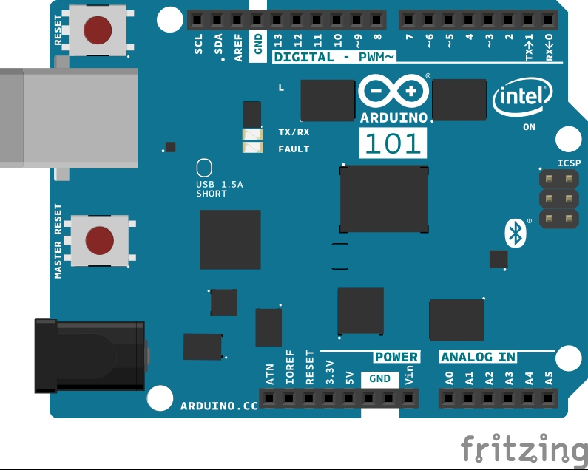
Arduino 101

Slide 10
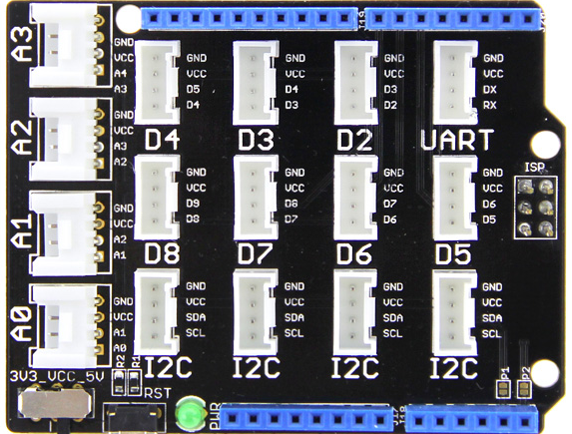
Grove Base Shield

Slide 11
Grove cable & SENSORS

Slide 12
Grove cable & SENSORS

Slide 13
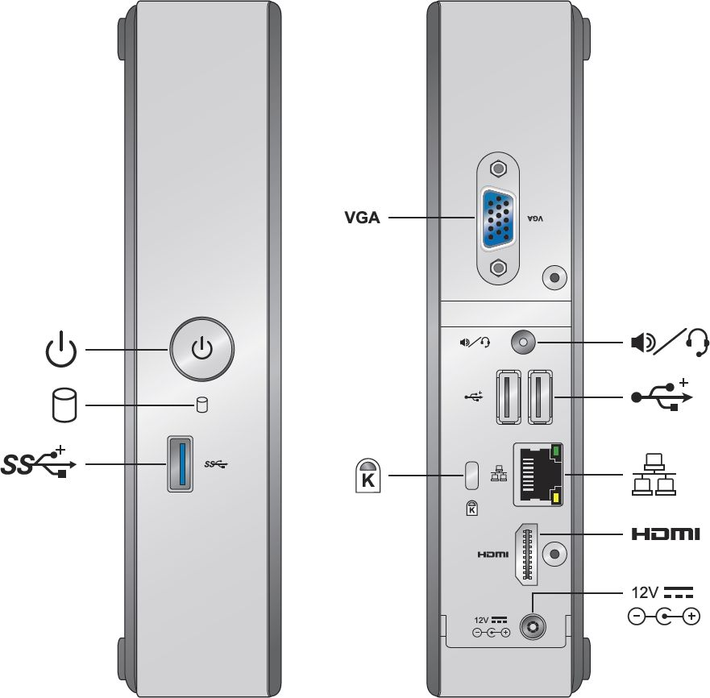
INTEL NUC DE3815TYKE

Slide 14
GALILEO BOARD

Slide 15
RASPBERRY PI

Slide 16
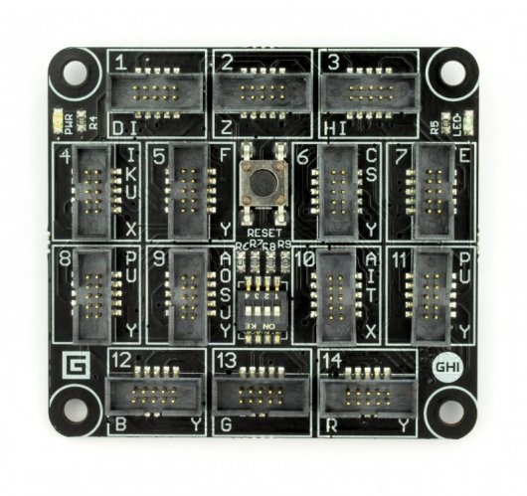
FEZ SPIDER MAIN BOARD

Slide 17
Sparkfun weather shield

Slide 18
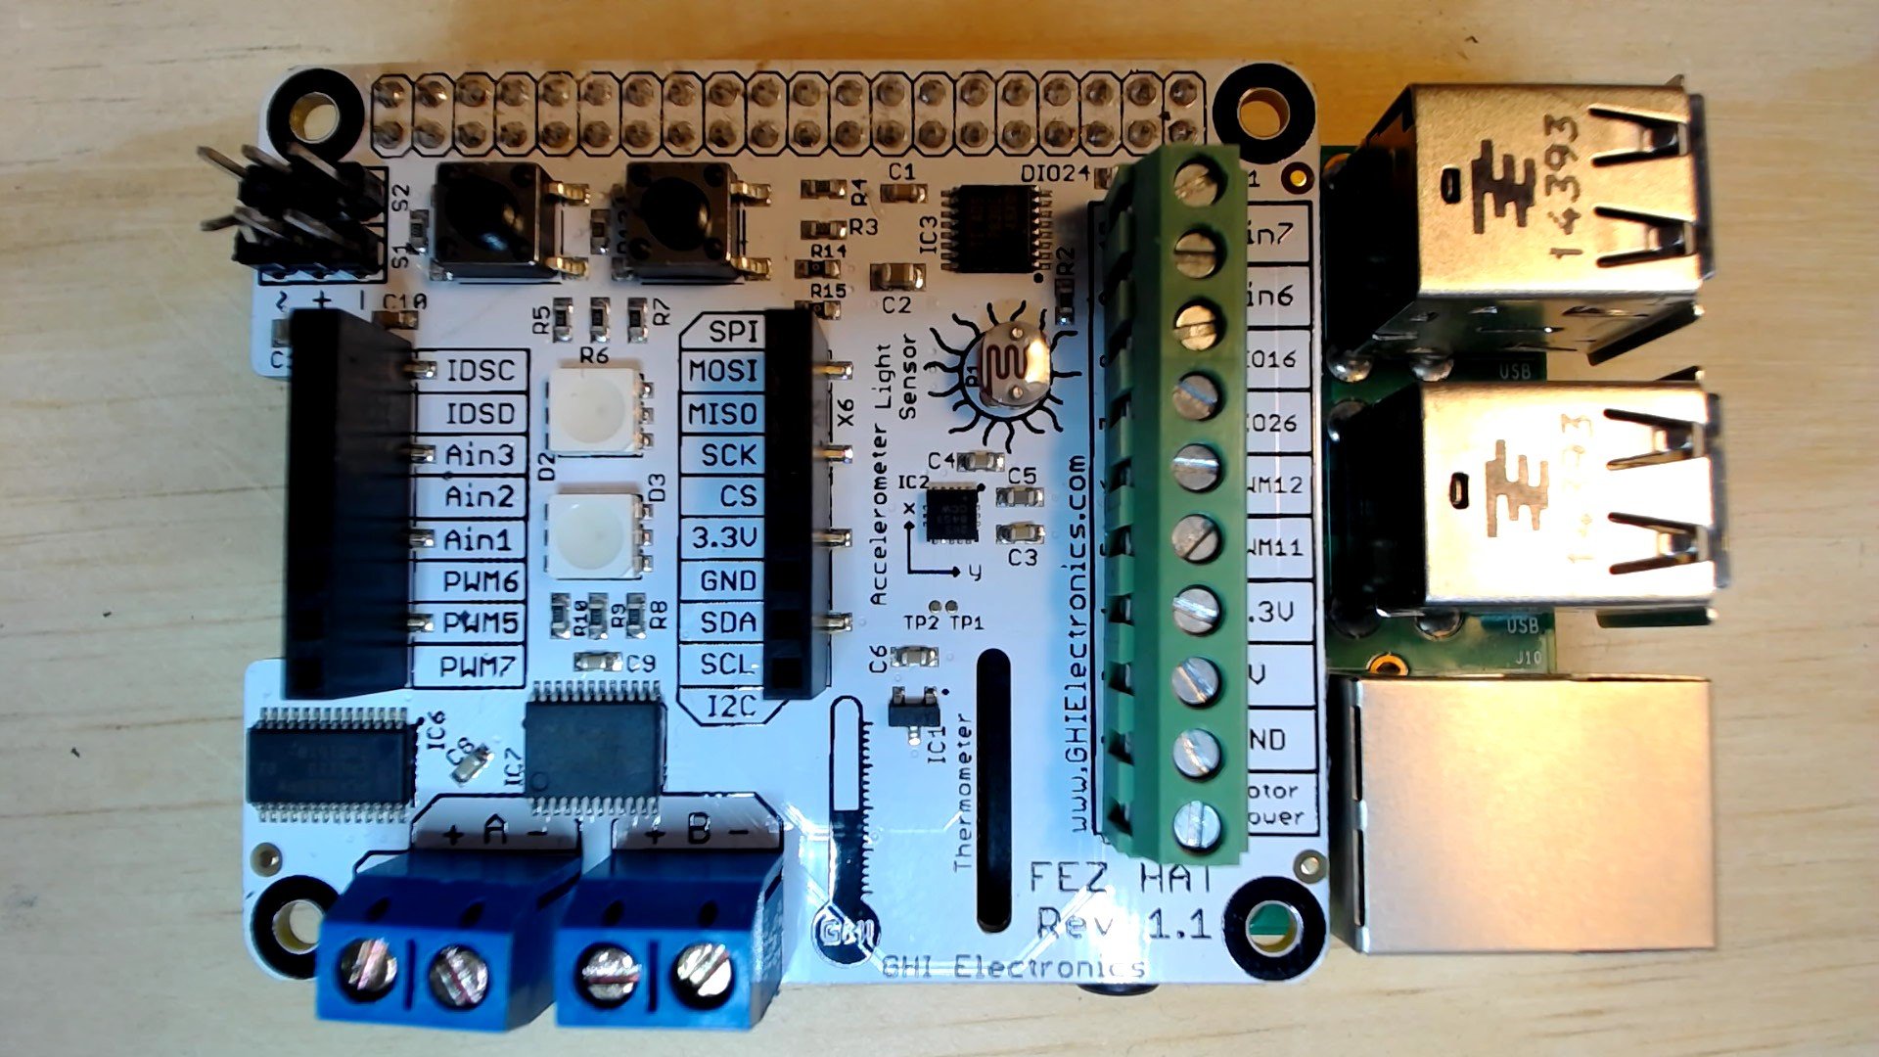
FEZ HAT

Slide 19
Connect the dots azure icons
Event Hubs
Stream Analytics
Storage
(
Azure
Microsoft Azure
Web App
Service Bus
)
Storage blob
Storage table
SQL database
HDInsight
Machine
(
Learning
GitHub code
Git repository
generic
)

Slide 20
LEDs

Slide 21
Resistors
220Ω
1st Digit
2nd Digit
Multiplier
Tolerance
Color | Name | 1st Digit | 2nd Digit | Multiplier | Tolerance
 | Black | 0 | 0 | X1
 | Brown | 1 | 1 | X10 | 1%
 | Red | 2 | 2 | X100
 | Orange | 3 | 3 | X1,000
 | Yellow | 4 | 4 | X10,000
 | Green | 5 | 5 | X100,000
 | Blue | 6 | 6 | X1,000,000
 | Violet | 7 | 7
 | Grey | 8 | 8
 | White | 9 | 9
 | Gold |  |  | X0.1 | 5%
 | Silver |  |  | X0.01 | 10%
330Ω
10KΩ

Slide 22
cables

Slide 23
More cables and adapters

Slide 24

LEDs
Anode (+)
Cathode (-)
Flat Edge
Small Post
Big Post
Long Leg
Short Leg
Vcc (+)
GND

Slide 25
LEDs

Slide 26
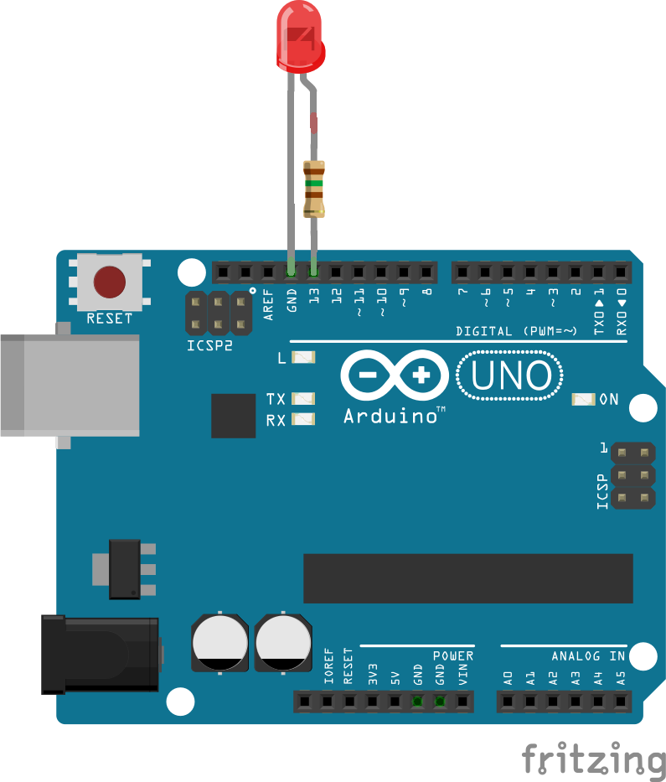
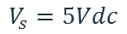
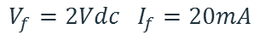
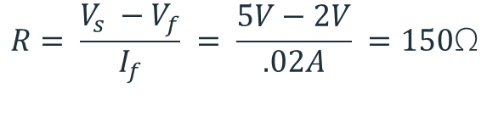
Current limiting resistors
Providing more current than an LED is rated for can destroy the LED. To prevent that, you should use a “Current Limiting” resistor.
To calculate the value of the resistor you need to know the supply voltage (Usually 5V on the Arduino Uno), and the LEDs rated Forward Voltage (the voltage drop across the LED) and Forward Current (the maximum current the LED can handle).
$$V_{f}=2Vdc I_{f}=20mA$$
$$Resistor Value (R)= \frac{Supply Voltage \left(V_{s}\right)−LED Forward Voltage (V_{f}) }{LED Forward Current (I_{f})}$$
$$V_{s}=5Vdc$$
$$R= \frac{V_{s} −V_{f}}{I_{f}} = \frac{5V−2V}{.02A} =150\text{Ω}$$
The Arduino Uno has a built in current limiting resistor on Pin 13. If you use Pin 13 to power your LED you can use it without a separate resistor.

Slide 27
Resistors
220Ω
1st Digit
2nd Digit
Multiplier
Tolerance
Color | Name | 1st Digit | 2nd Digit | Multiplier | Tolerance
 | Black | 0 | 0 | X1
 | Brown | 1 | 1 | X10 | 1%
 | Red | 2 | 2 | X100
 | Orange | 3 | 3 | X1,000
 | Yellow | 4 | 4 | X10,000
 | Green | 5 | 5 | X100,000
 | Blue | 6 | 6 | X1,000,000
 | Violet | 7 | 7
 | Grey | 8 | 8
 | White | 9 | 9
 | Gold |  |  | X0.1 | 5%
 | Silver |  |  | X0.01 | 10%
330Ω
10KΩ

Slide 28
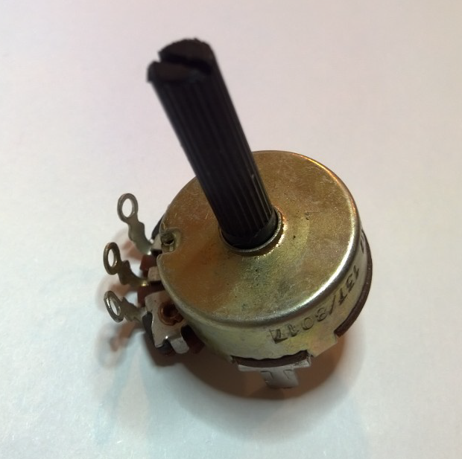
Potentiometer – variable resistor

Slide 29
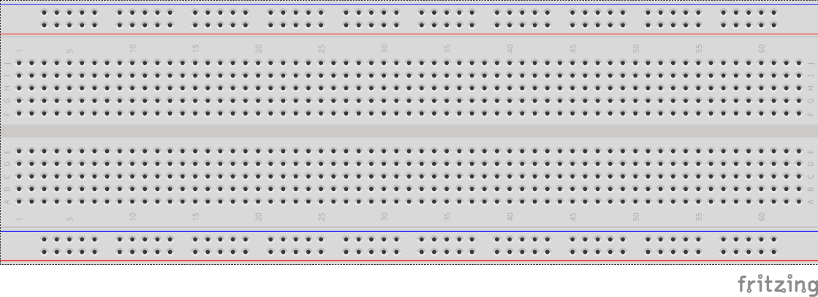
breadboards
Breadboards offer a great way to prototype circuits. The provide a number of “buses” for connecting both power and components.
Power buses run the entire horizontal length
Component buses give you easy ways to connect pins together

Slide 32
Micro SD Cards
Font: Segoe UI Semibold

